Slide 1
General Introduction
24.10.24
Machine Learning With TensorFlow

Slide 2
Personal Introduction
Intro to opencampus.sh
Organizational Matters
Introductory Discussion on AI
Coursera Registration
Course Projects
ML Frameworks

Slide 3
Introduction of the Instructors
Notes:
Name, Location, Project Interest

Slide 4

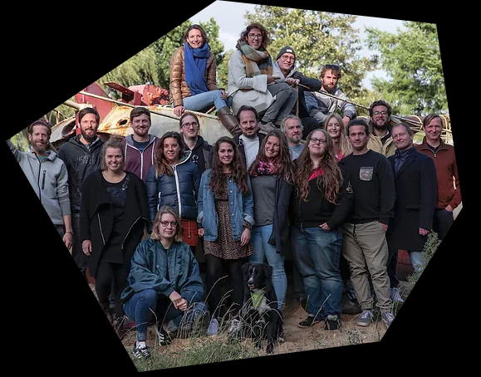
Nonprofit organization which oversees a variety of initiatives
Offering a wide range of educational opportunities, support, and networking for entrepreneurs, creatives, and anyone curious, regardless of age, educational background, or origin
The services are open to everyone and mostly free.
The goal is to support the entrepreneurial landscape, promote creative change processes, and contribute to innovative and sustainable future development.

Slide 5
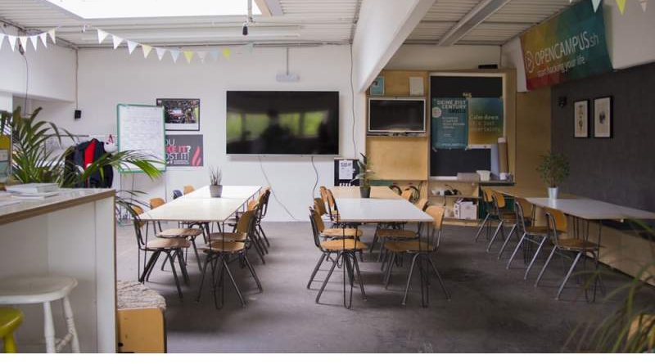
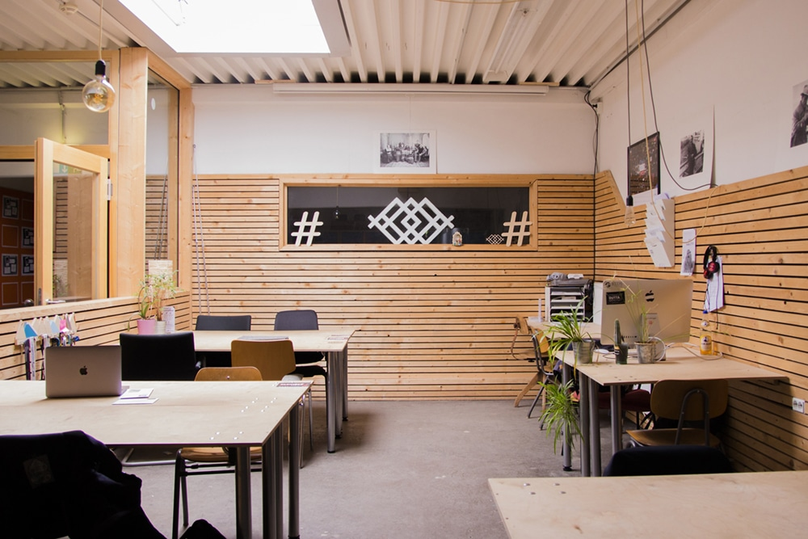



Slide 6




Slide 7


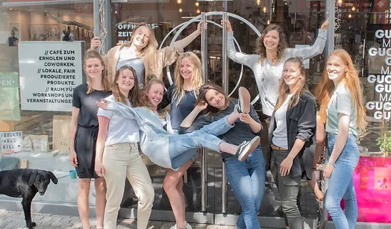
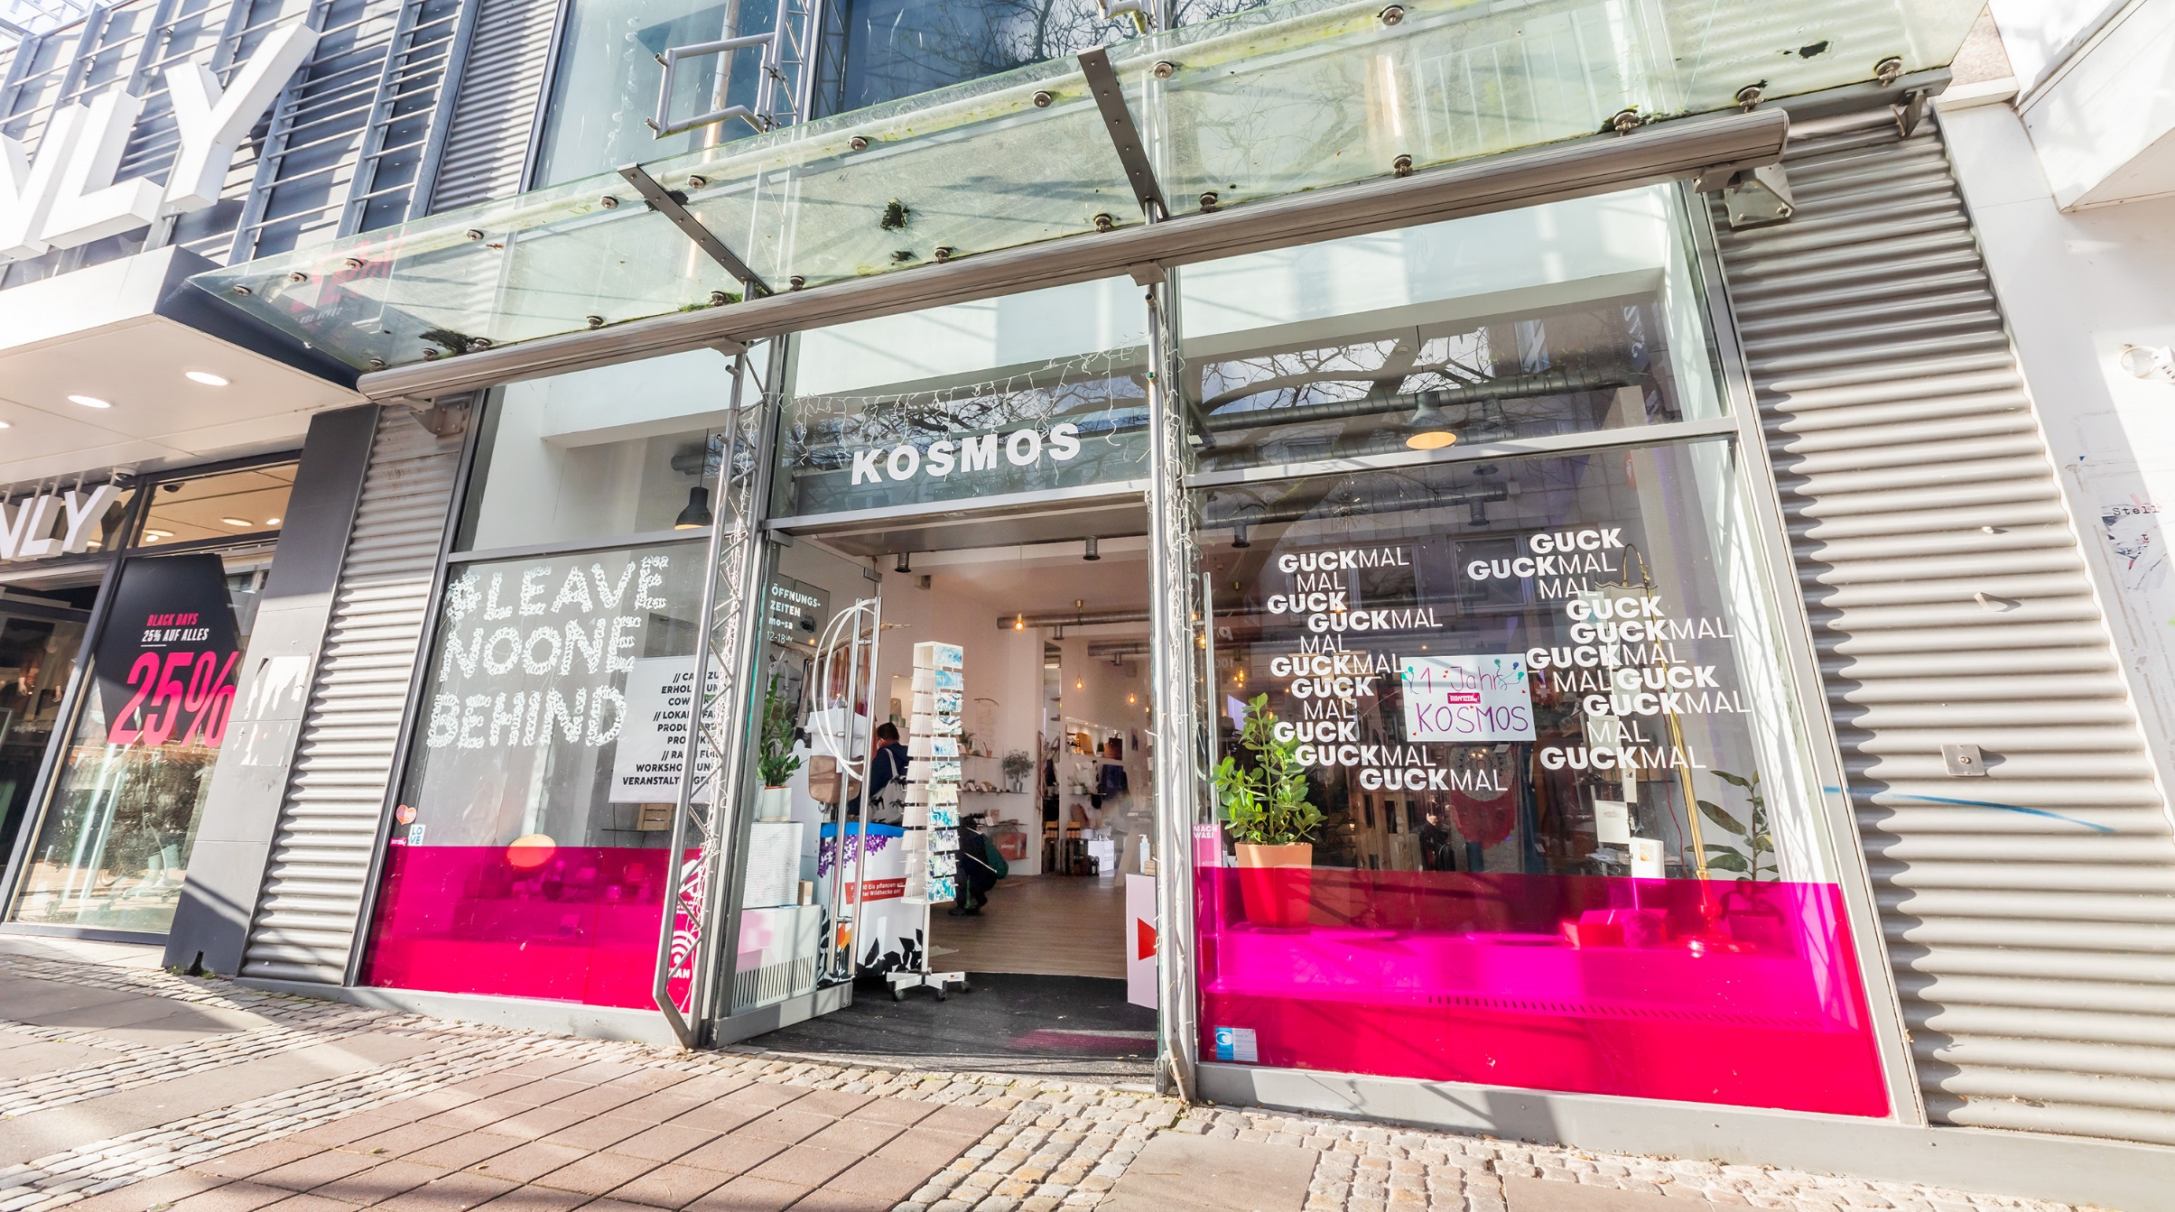

Slide 8
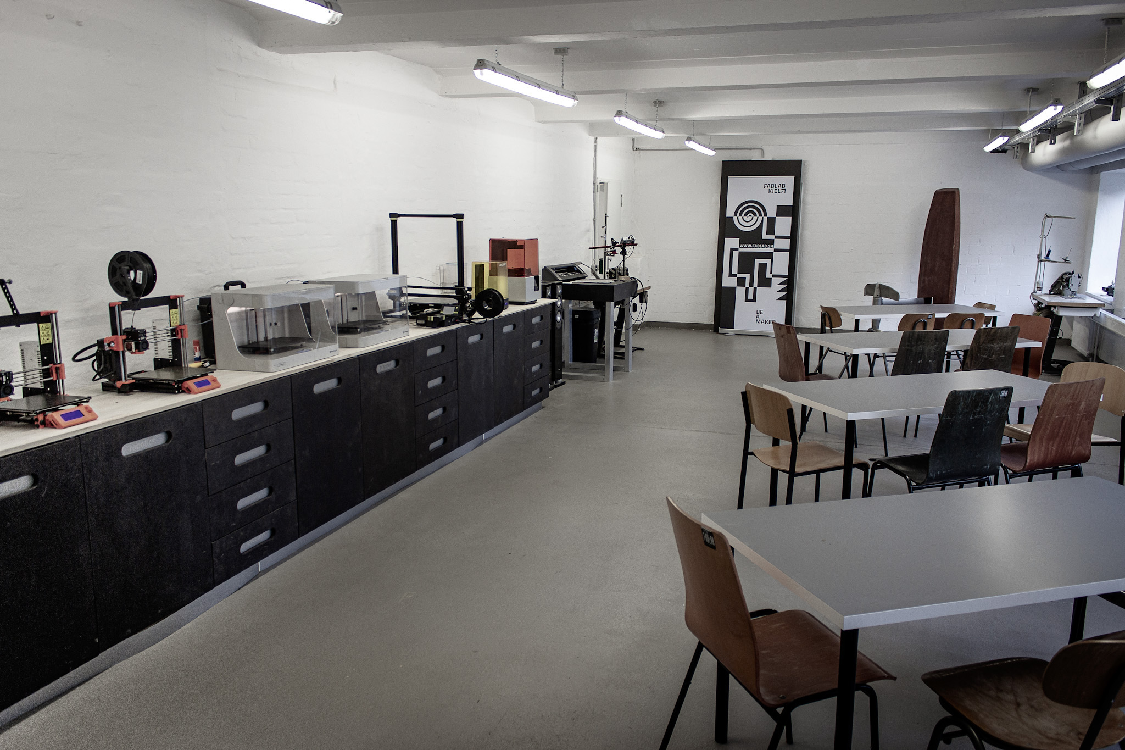
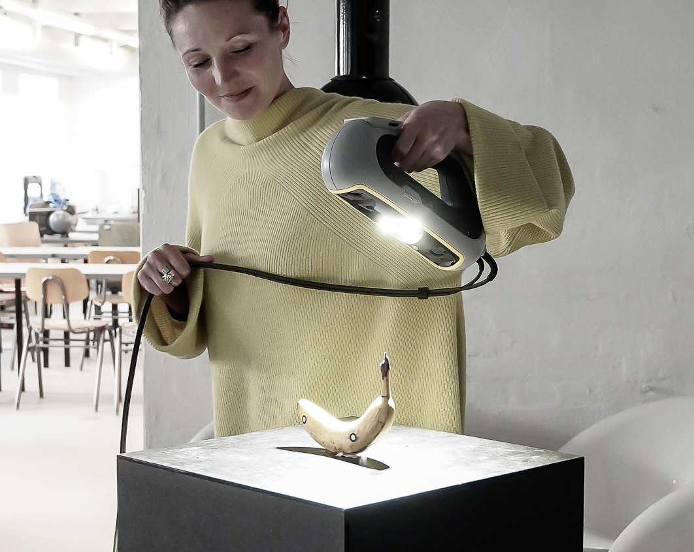
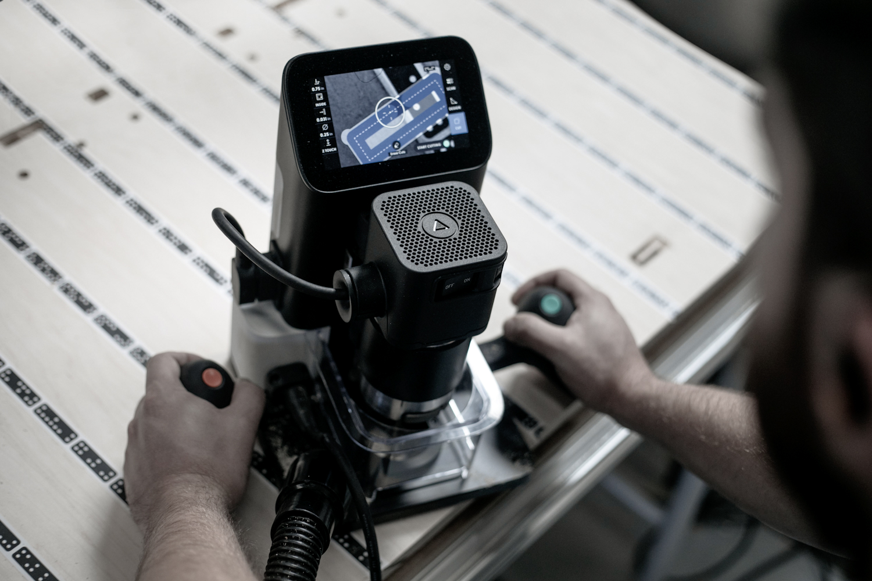



Slide 9



Slide 10
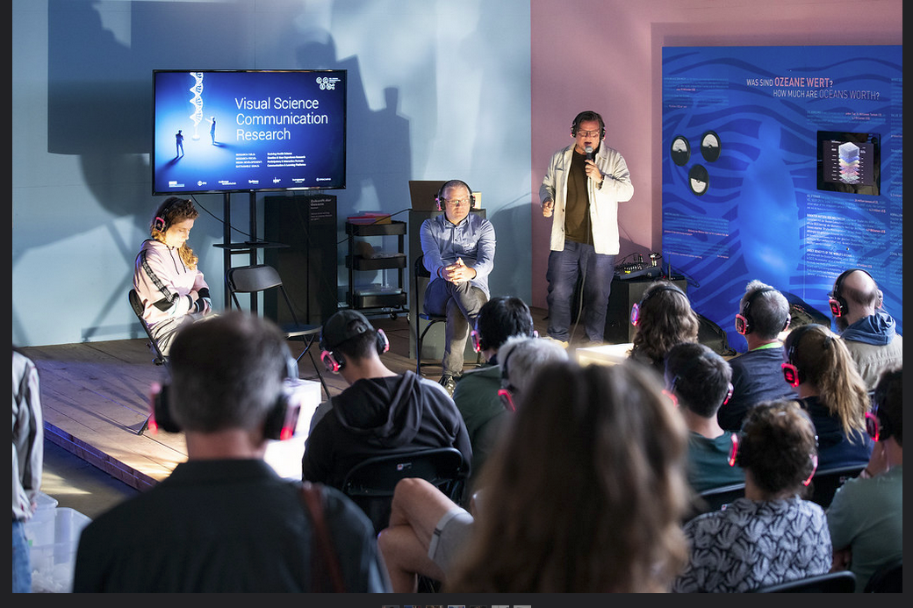
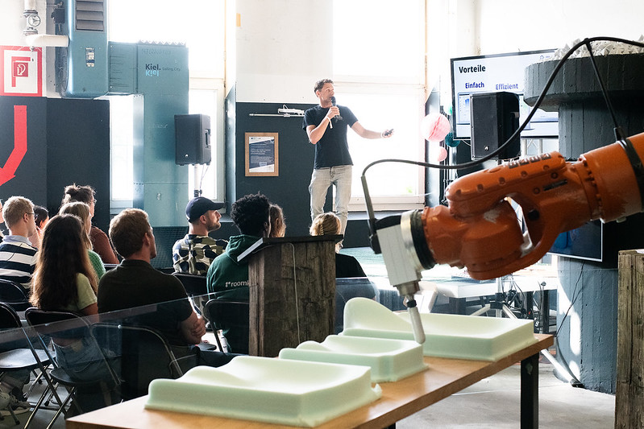

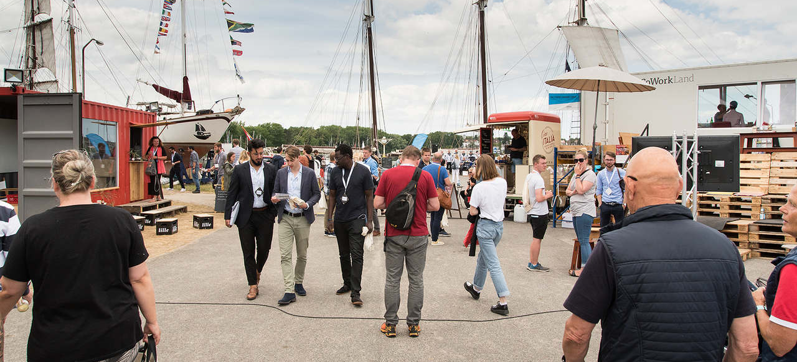
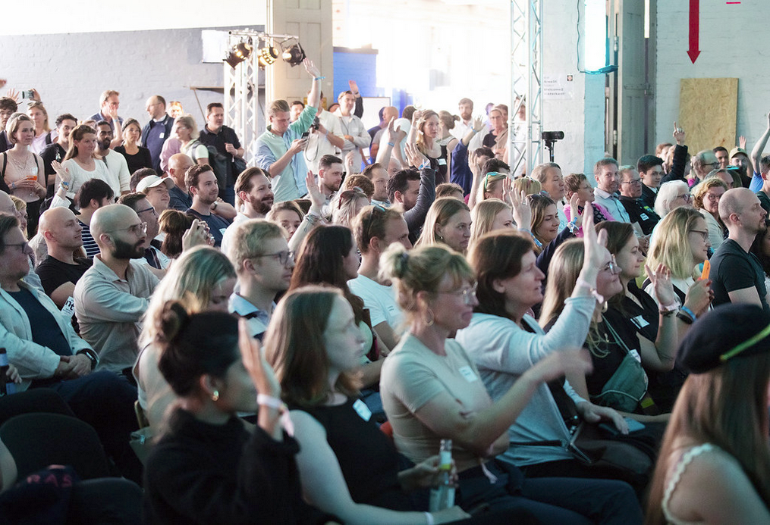
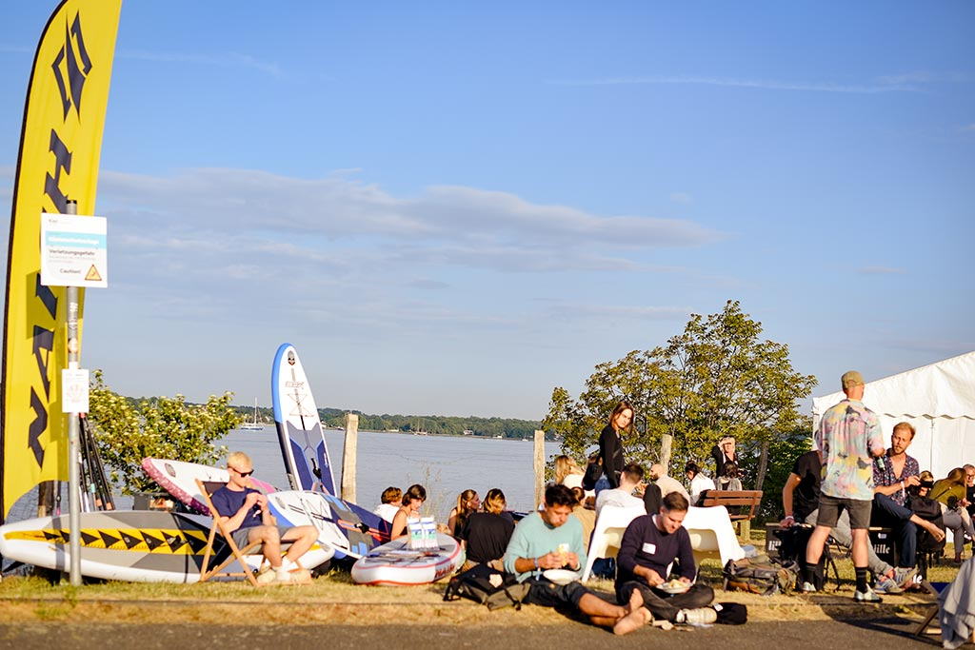

Slide 11
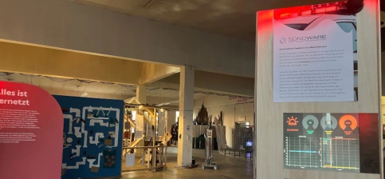

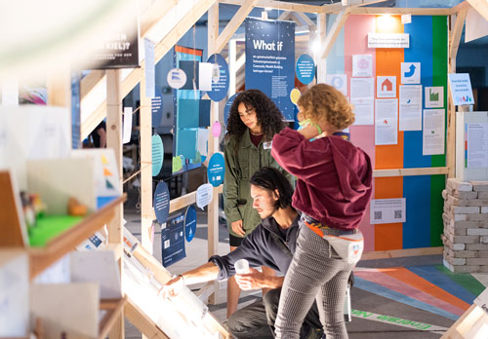
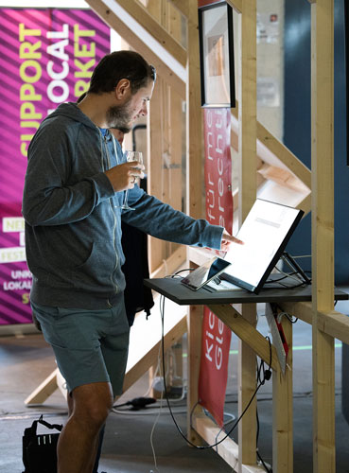
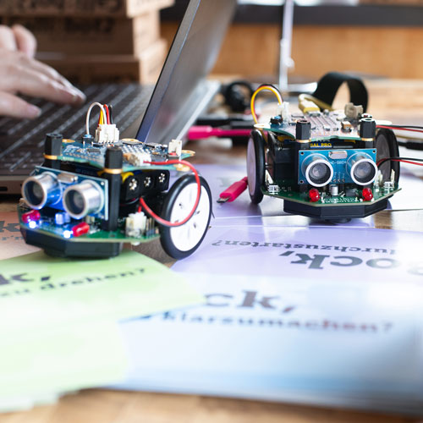


Slide 12
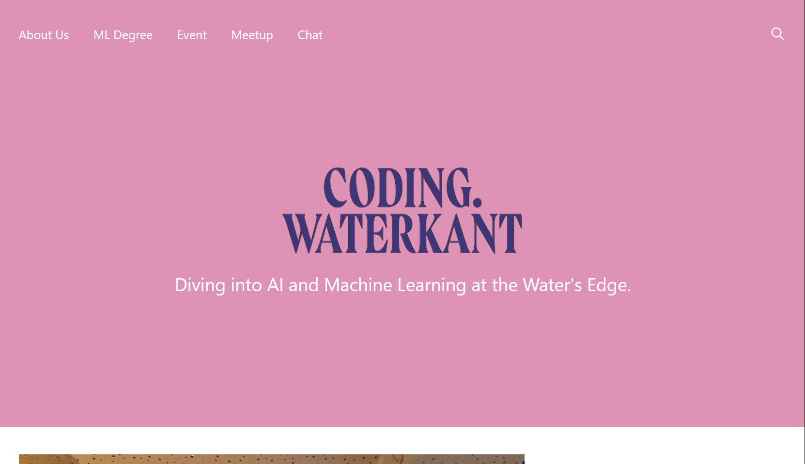
https://coding.waterkant.sh

Slide 13
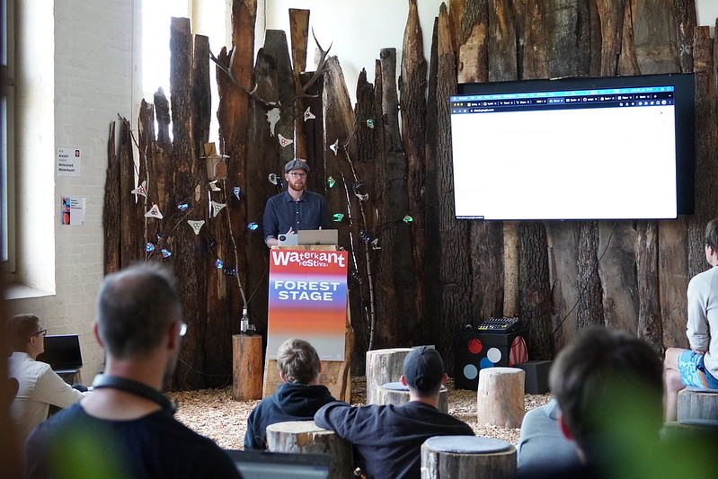

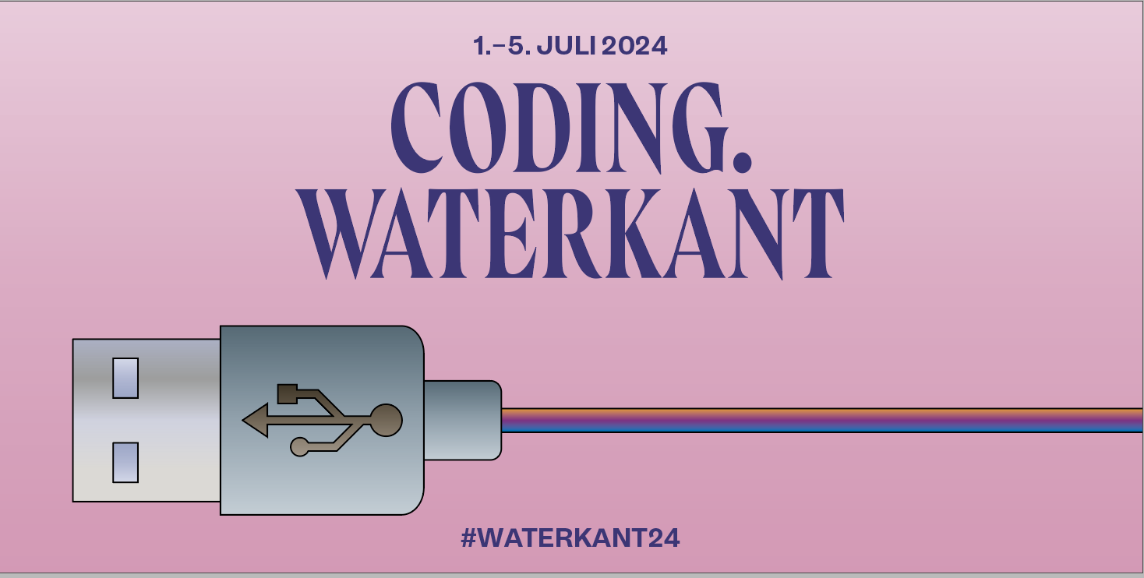
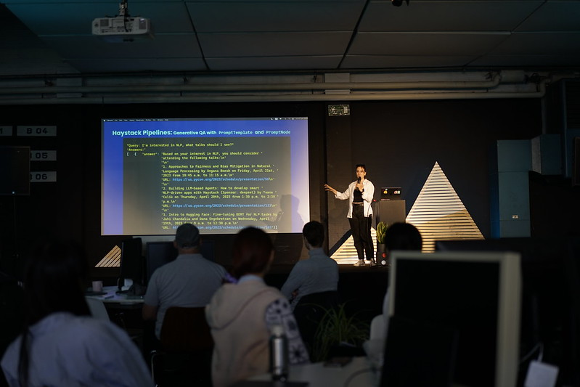


Slide 14
Work for four consecutive days:
on your own machine learning project or
support others in their project
Take part in workshops
Get input and feedback by invited experts
Present your work to a larger audience.
Take educational leave
Get accommodation on site

Slide 15
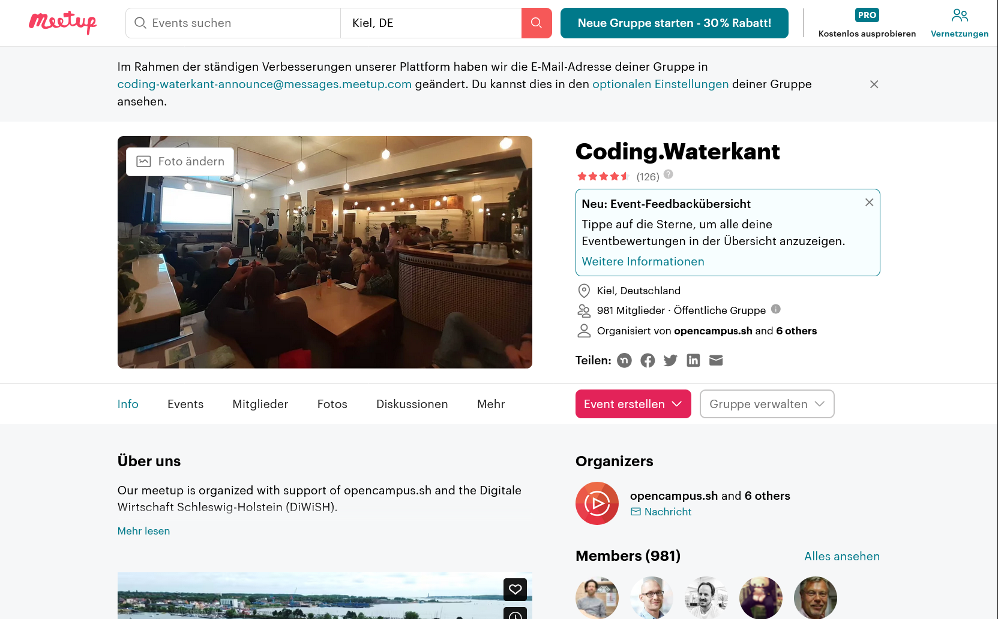

Slide 16
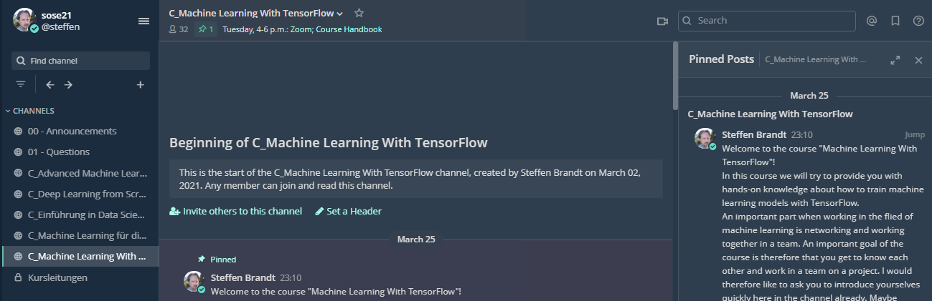
Chat
Please, ask questions to us in the chat

Slide 17
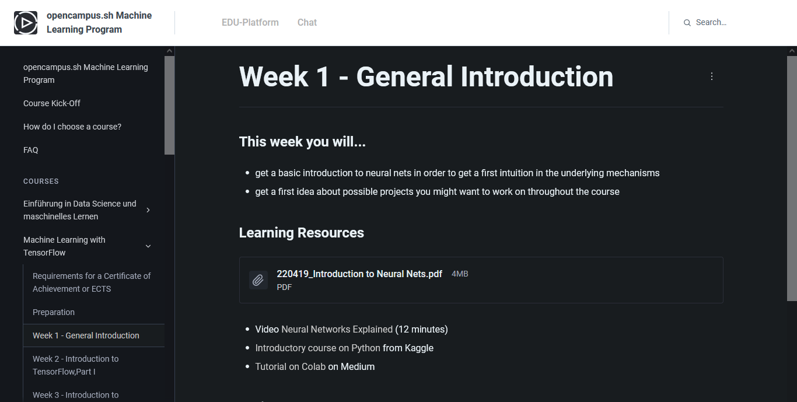
Course handbook

Slide 18
Organizational Matters
Use your full names in the zoom meetings!
Scan the QR-Code if you participate in presence
Complete your profile in the Mattermost chat with your full name and a photo.
Please write us if you will not go on with the course!

Slide 19
Zoom
Try the different viewing modes:
Gallery View/ Active Speaker
Split Screen/ Full Screen Mode
Maybe watch this video to get an idea:
https://www.youtube.com/watch?v=v3IPAbpVjd4

Slide 20
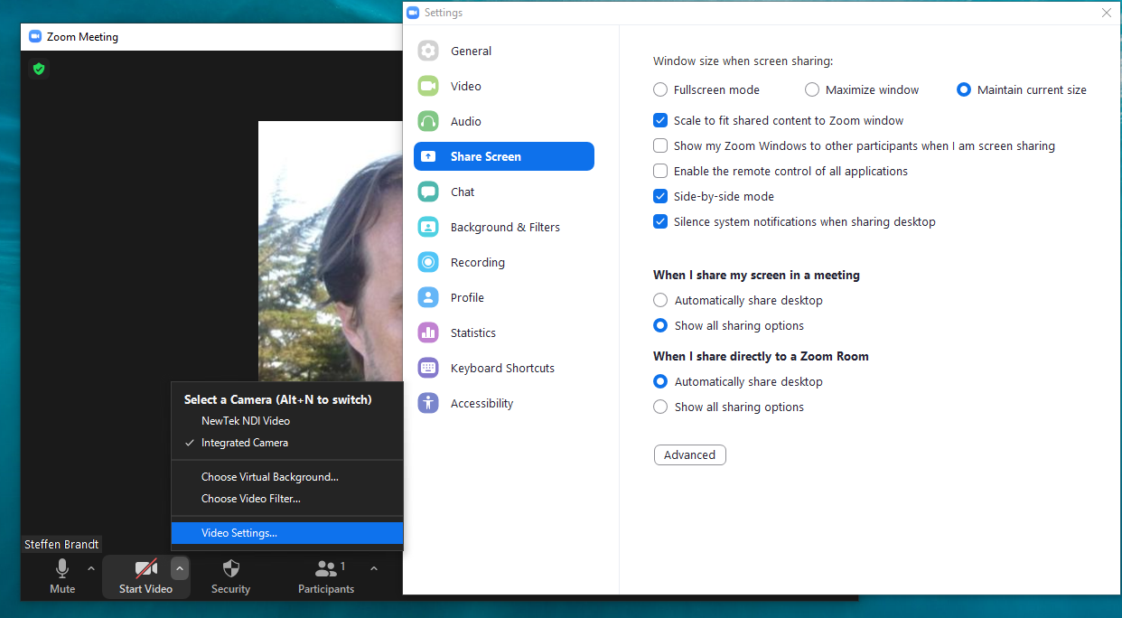

Slide 21
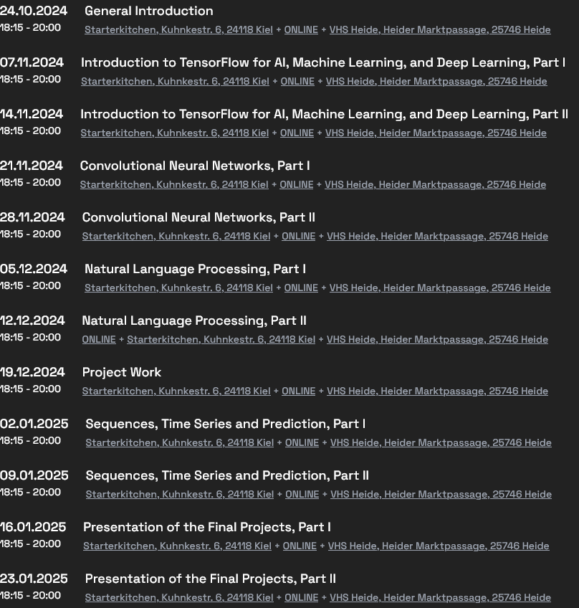

Slide 22
24.10.2024 , 18:15 - 20:00
General Introduction
Steffen & Hannes
07.11.2024 , 18:15 - 20:00
Introduction to TensorFlow
Jake
14.11.2024, 18:15 - 20:00
Introduction to TensorFlow
Hannes
21.11.2024, 18:15 - 20:00
Convolutional Neural Networks, Part I
Jeremy
28.11.2024, 18:15 - 20:00
Convolutional Neural Networks, Part II
Steffen
05.12.2024, 18:15 - 20:00
Natural Language Processing, Part I
Hannes
12.12.2024, 18:15 - 20:00
Natural Language Processing, Part II
Jake
19.12.2024, 18:15 - 20:00
Project Work
Alle
02.01.2025, 18:15 - 20:00
Sequences, Time Series and Prediction, Part I
Jeremy
09.01.2025, 18:15 - 20:00
Sequences, Time Series and Prediction, Part II
Jeremy
16.01.2025, 18:15 - 20:00
Presentation of the Final Projects, Part I
Hannes & Steffen
23.01.2025, 18:15 - 20:00
Presentation of the Final Projects, Part II
Hannes & Steffen

Slide 23
First Breakout
15-20 Minutes
Present yourself
Discussion Questions:
Do you know examples for Machine Learning?
Do you know examples for Deep Learning?

Slide 24
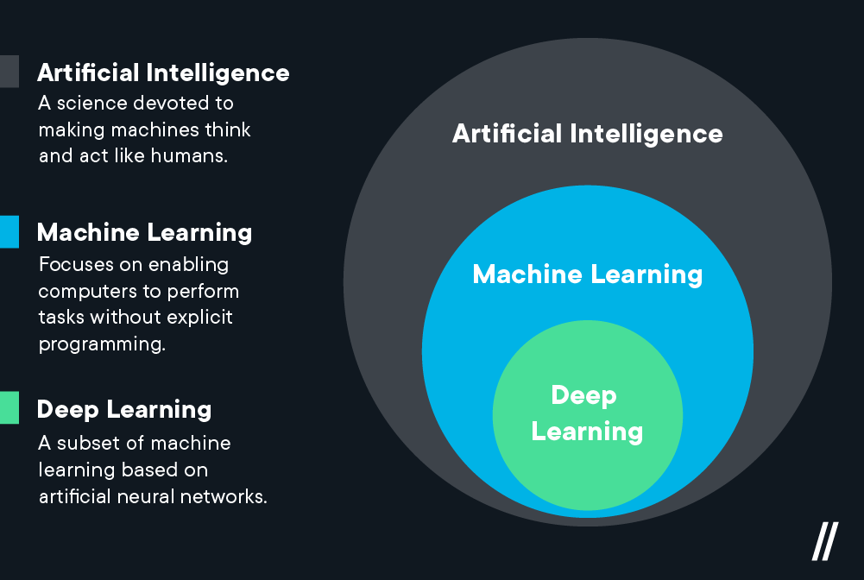
Deep Learning vs. Machine Learning—What’s the Difference? (2021, February 8). Flatiron School. https://flatironschool.com/blog/deep-learning-vs-machine-learning/

Slide 25
“What's the difference between data science, machine learning, and artificial intelligence?”
http://varianceexplained.org/r/ds-ml-ai
Data science produces insights.
Machine learning produces predictions.
Artificial intelligence produces actions.

Slide 26
Artificial Intelligence
„an autonomous agent executes or recommends actions“
(Poole, Mackworth, & Goebel, 1998)
„Systems with 'intelligent' behavior that analyze their environment and act with a certain degree of autonomy to achieve certain goals. “
(European Commission, 2018)
„By artificial intelligence we mean highly developed software systems that are capable of learning and training to master complex tasks.“
(AI-Strategy of the State Schleswig-Holstein, 2019)
Notes:
Es gibt keine Definition von KI!

Slide 27
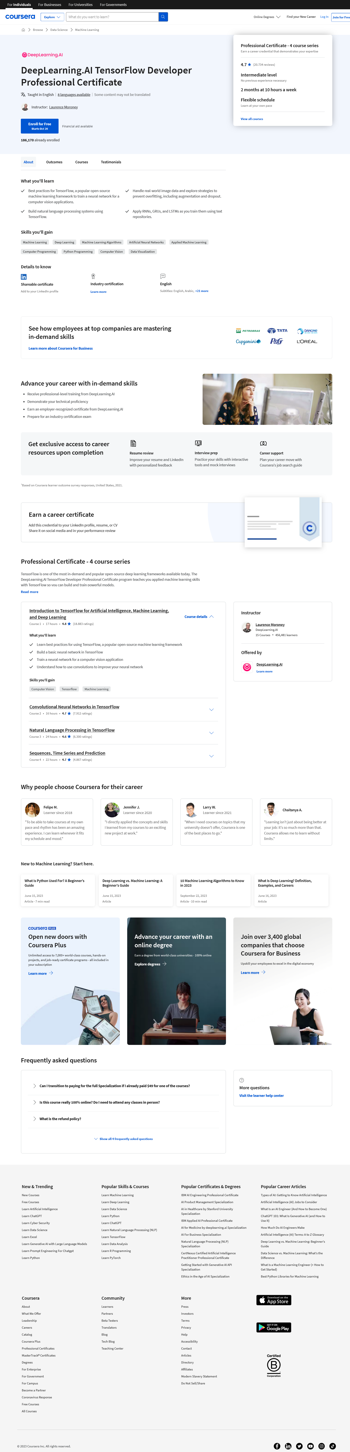
Do not sign up for the Specialization
X

Slide 28
Click on the individual course

Slide 29
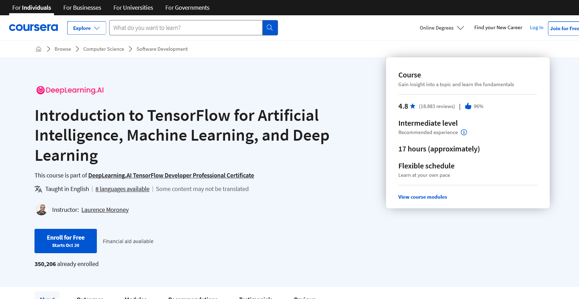
Enroll for individual course

Slide 30
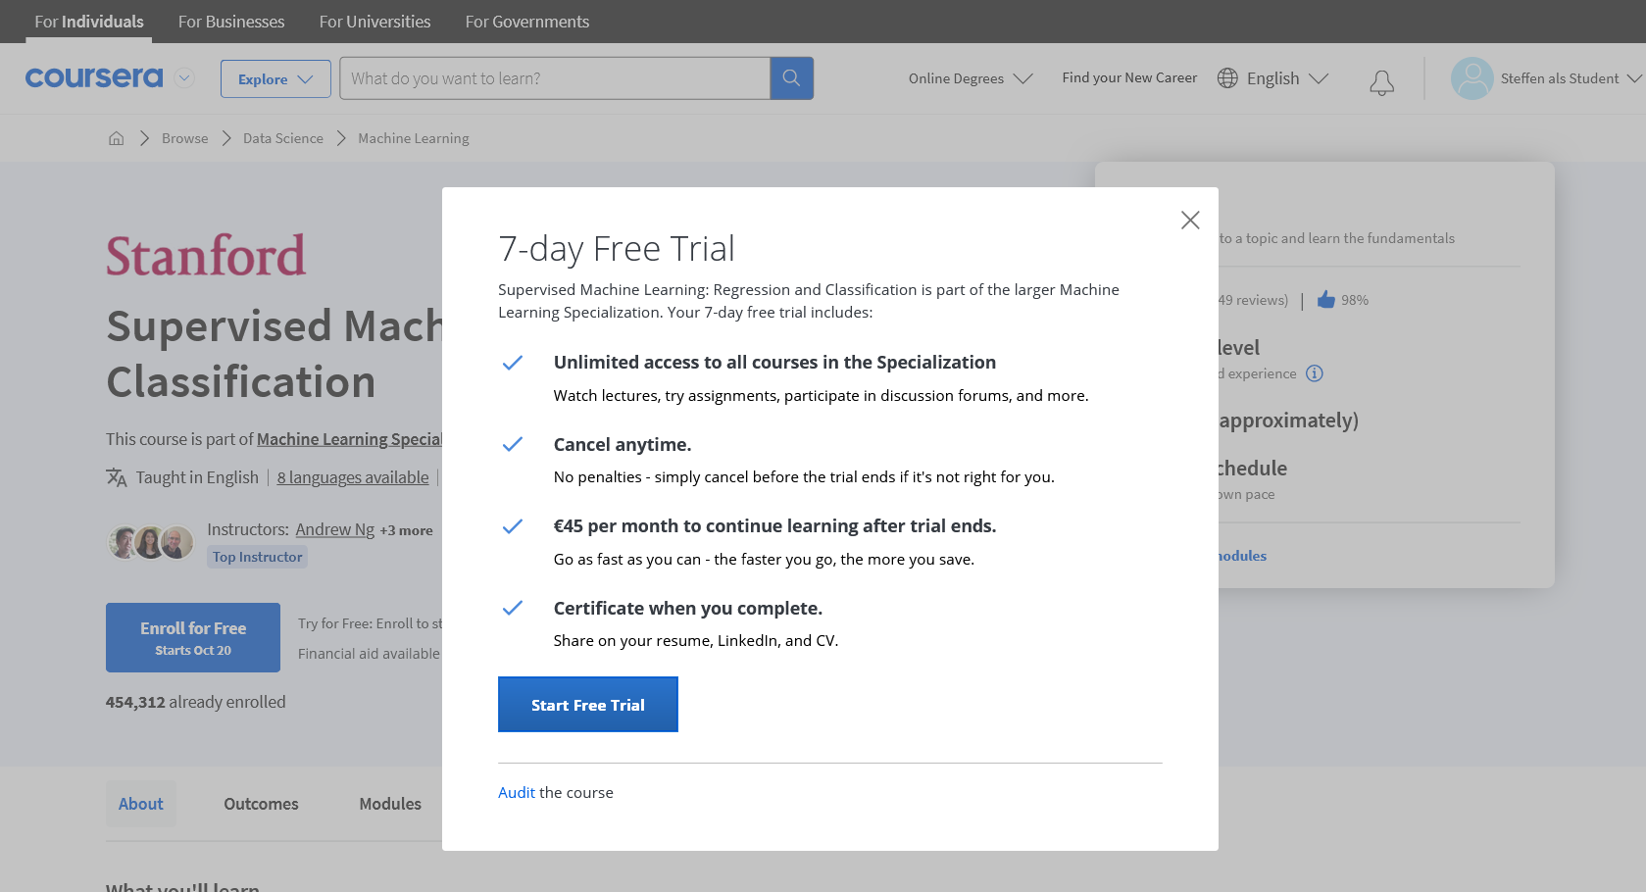
Select Audit modus

Slide 31
Exercises
Each week two to four of you will present the exercises given in the course handbook
Each of you presents at least once
Notes:
How many persons should present depends largely on the number of participants. Don’t warry if there are far more participants then sessions to present exercises. Usually, it works out at the end. ☺ If at the end not everyone presents it is also ok, but you want to make it as mandatory as possible, so people do it and you don’t have trouble each time in finding persons two present.

Slide 32
Exercises: Who will present next week?
Notes:
Usually the first ones are by far the easieast. Make it attractive to be under the first ones.

Slide 33
Projects
Option 1:
Bring your own idea and data
Option 2:
Do one of the two default projects

Slide 34
Relevance of the Projects
Most important for a career in ML will be work experience and your GitHub profile
Focus on building a noteworthy GitHub project repository
Use the template repository
Outstanding projects will be nominated for the VDE prize

Slide 35

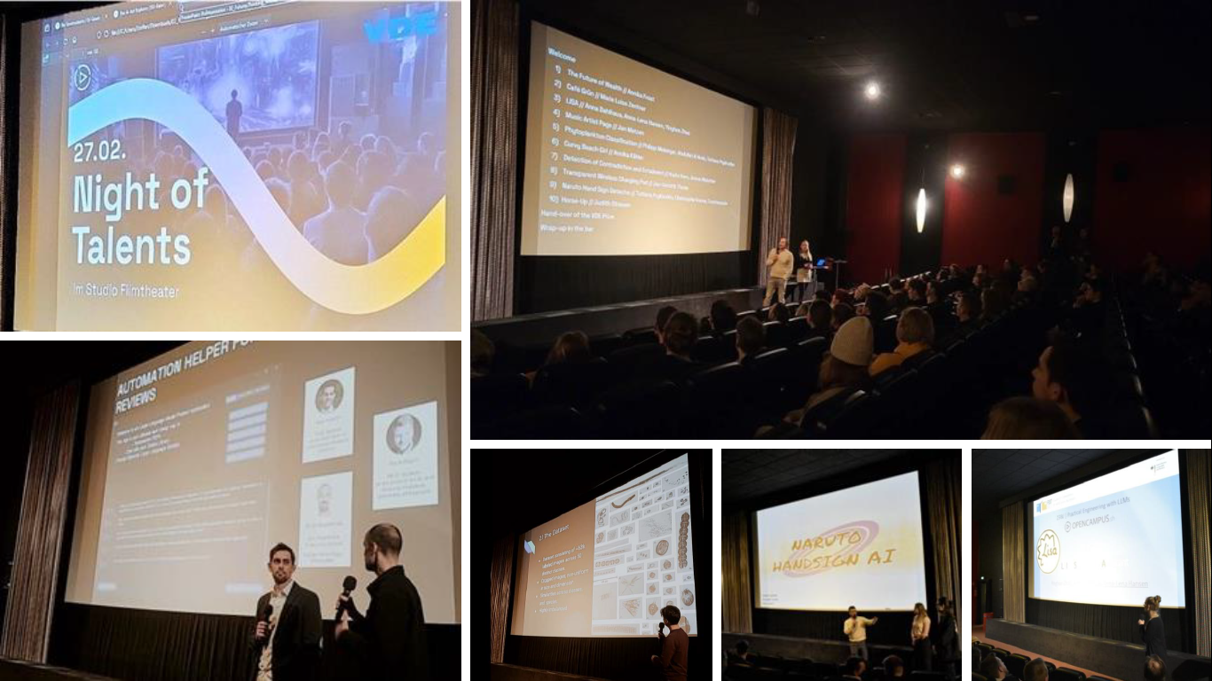
Special Prize Machine Learning

Slide 36
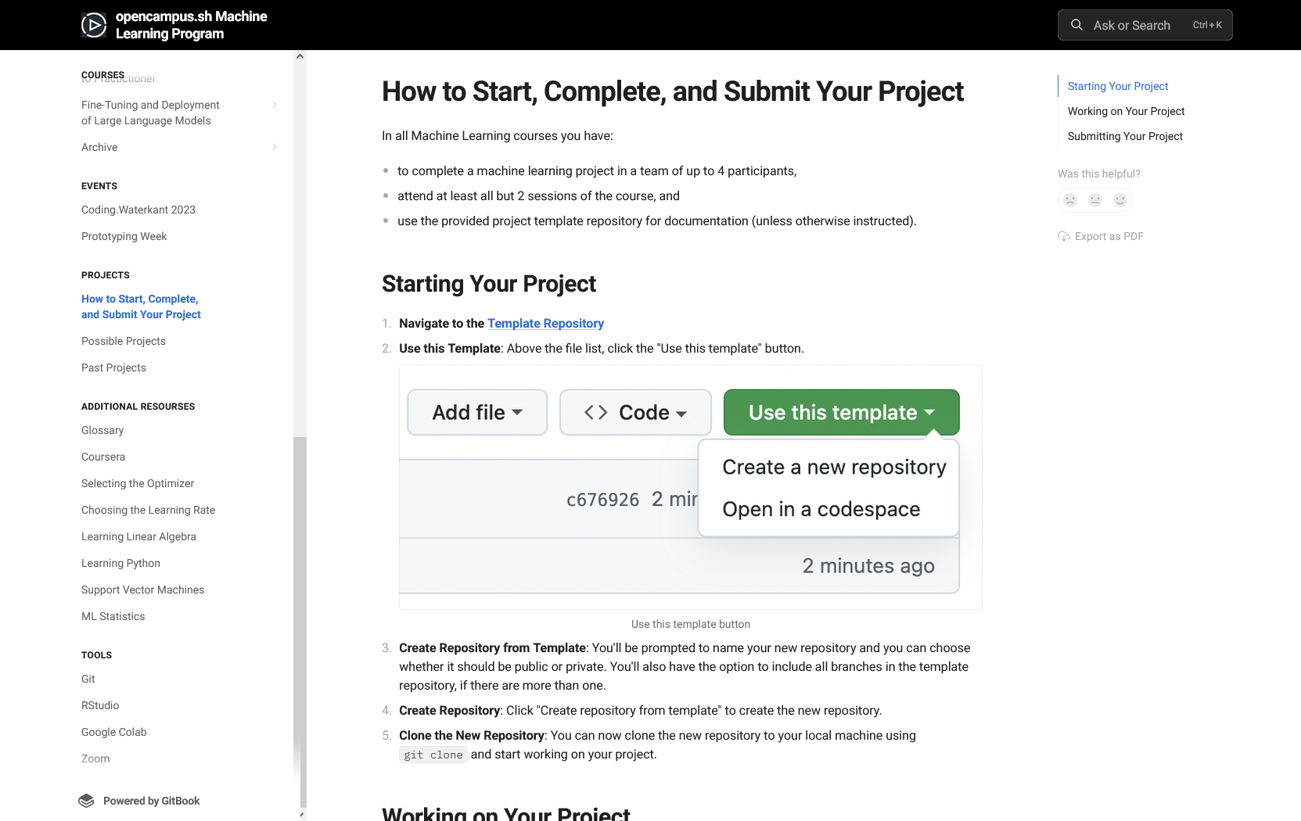

Slide 37
project interests

Slide 38
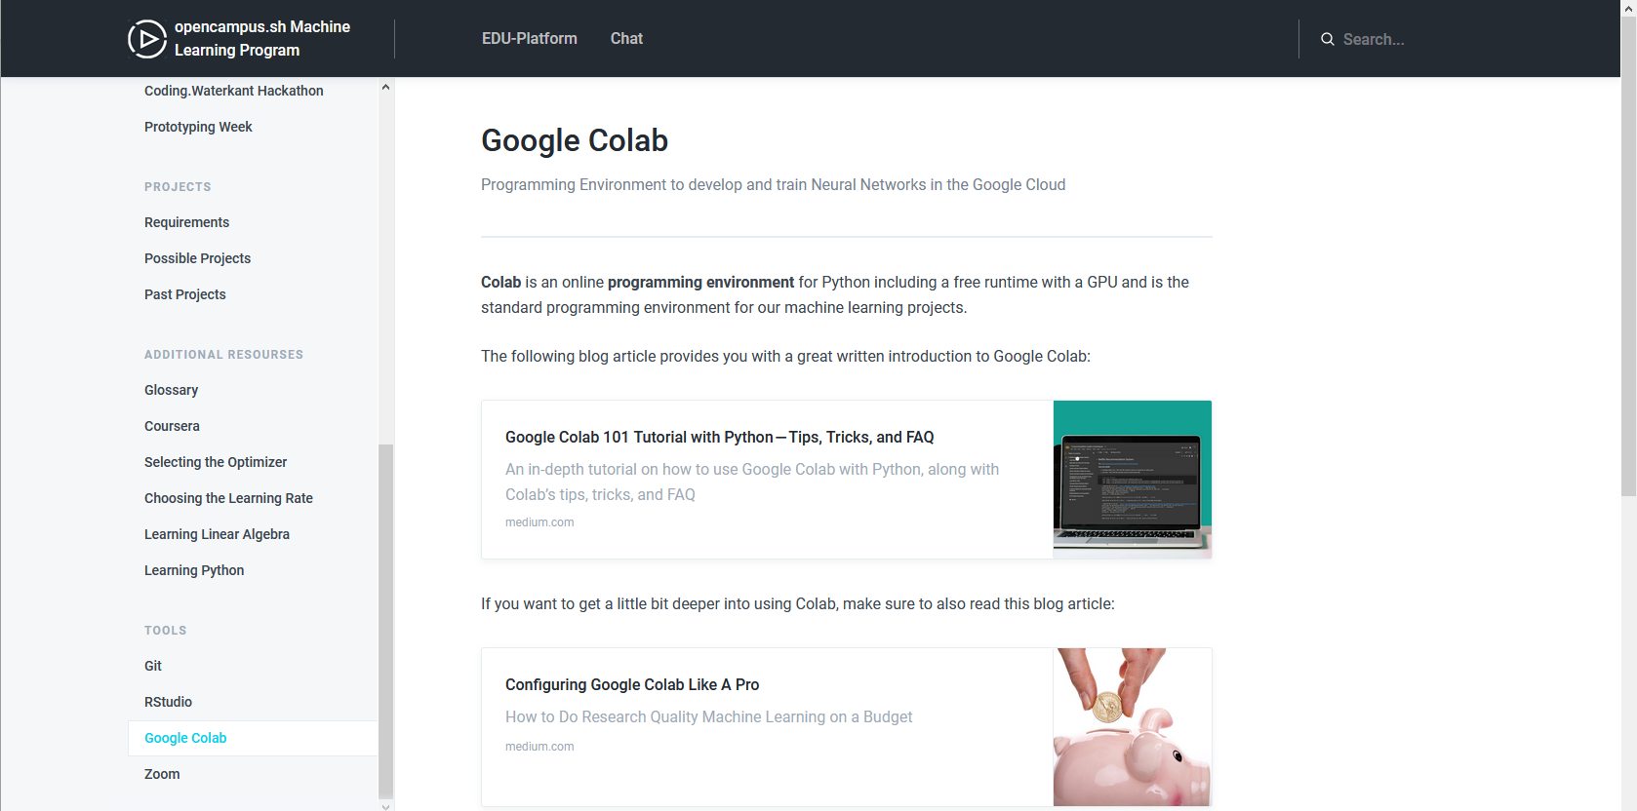
Google Colab

Slide 39
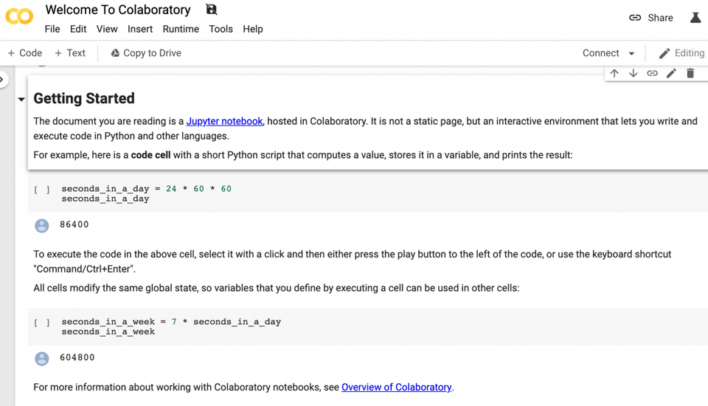

Slide 40
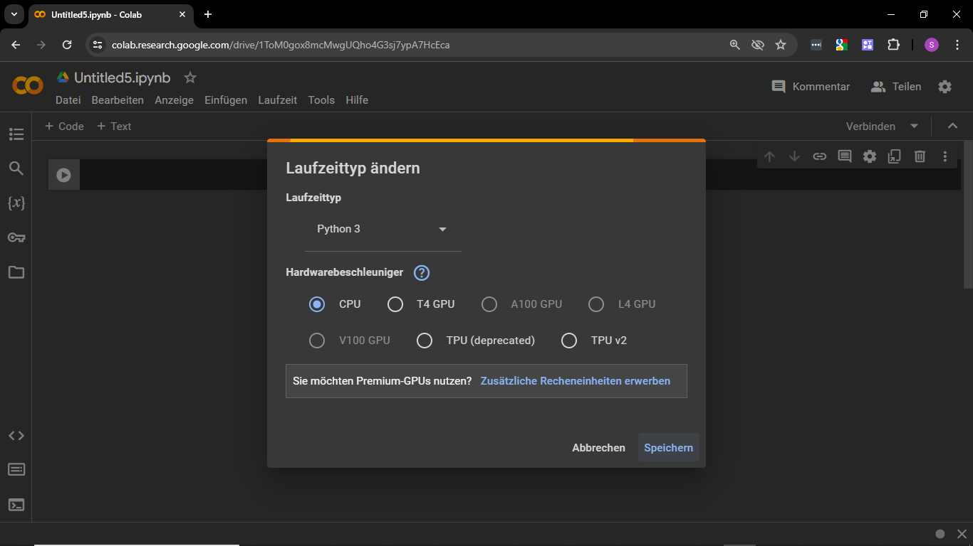

Slide 41




ML Libraries (lower level)
Notes:
This slide an the following two include some preparatory content, we typically included in the first session of the TensorFlow course. This could basically be anything you find interesting considering the course content. If you cannot think about anything you want to talk about here, it is also fine to skip directly to your last slide.
--------------------------------------------------------------------- Usually, I take notes in slides, which is also nice if you want to re-use slides at a later point in time. At least, I can never remember what I wanted to say to a slide (also I try not put to much text on slides). These are the ones for this slide:
TensorFlow: Used by Google [Python, C/C++, Java, Go, R, Swift, JavaScript; Keras only Python and R]
PyTorch: Used by Facebook, IBM, Yandex, and Idiap Research Institute (IDSIA), since recently now also Microsoft. Friendly programming language with useful error messages, a huge repository of sample code, guides, and a helpful community [Python]
CNTK: Is more popular in the speech recognition arena but can also be used for text and image training. Easy to use. [Python, C++, C#/.NET, Java, BrainScript]
SciKit Learn: Efficient tool for statistical modeling techniques namely classification, regression, clustering; good for data mining. [Python]
Caffe(2): Was developed for computer vision/image classification by leveraging Convolutional Neural Networks(CNNs). Caffe is popular for its Model Zoo, which is a set of pre-trained models that doesn’t require any coding to implement; used by academics and startups; Caffee2 is now part of PyTorch [Python, MATLAB, C++]
JAX: In very short it’s Numpy for GPUs.
Also see https://www.reddit.com/r/MachineLearning/comments/m3boyo/d_why_is_tensorflow_so_hated_on_and_pytorch_is/ for a nice discussion on the different frameworks.

Slide 42






ML Libraries (higher level)
Notes:
This slide an the following two include some preparatory content, we typically included in the first session of the TensorFlow course. This could basically be anything you find interesting considering the course content. If you cannot think about anything you want to talk about here, it is also fine to skip directly to your last slide.
--------------------------------------------------------------------- Usually, I take notes in slides, which is also nice if you want to re-use slides at a later point in time. At least, I can never remember what I wanted to say to a slide (also I try not put to much text on slides). These are the ones for this slide:
TensorFlow: Used by Google [Python, C/C++, Java, Go, R, Swift, JavaScript; Keras only Python and R]
PyTorch: Used by Facebook, IBM, Yandex, and Idiap Research Institute (IDSIA), since recently now also Microsoft. Friendly programming language with useful error messages, a huge repository of sample code, guides, and a helpful community [Python]
CNTK: Is more popular in the speech recognition arena but can also be used for text and image training. Easy to use. [Python, C++, C#/.NET, Java, BrainScript]
SciKit Learn: Efficient tool for statistical modeling techniques namely classification, regression, clustering; good for data mining. [Python]
Caffe(2): Was developed for computer vision/image classification by leveraging Convolutional Neural Networks(CNNs). Caffe is popular for its Model Zoo, which is a set of pre-trained models that doesn’t require any coding to implement; used by academics and startups; Caffee2 is now part of PyTorch [Python, MATLAB, C++]
JAX: In very short it’s Numpy for GPUs.
Also see https://www.reddit.com/r/MachineLearning/comments/m3boyo/d_why_is_tensorflow_so_hated_on_and_pytorch_is/ for a nice discussion on the different frameworks.

Slide 43





Development Environments

Slide 44
Feb 2017: TensorFlow 1.0 (Estimator API)
Nov 2017: TensorFlow 1.4 (Estimator API, Keras API)
Jan 2019: TensorFlow 2.0 (Estimator API, Keras API)

Slide 45
Tasks Until Next Week
Completion of the learning material of week 1 and 2 of the course "introduction to TensorFlow“
Complete the two assignments given in the following notebooks:
Assignment Notebook 1
Assignment Notebook 2
Bring questions!

